Slide 1
Matplotlib Tutorial

Slide 2
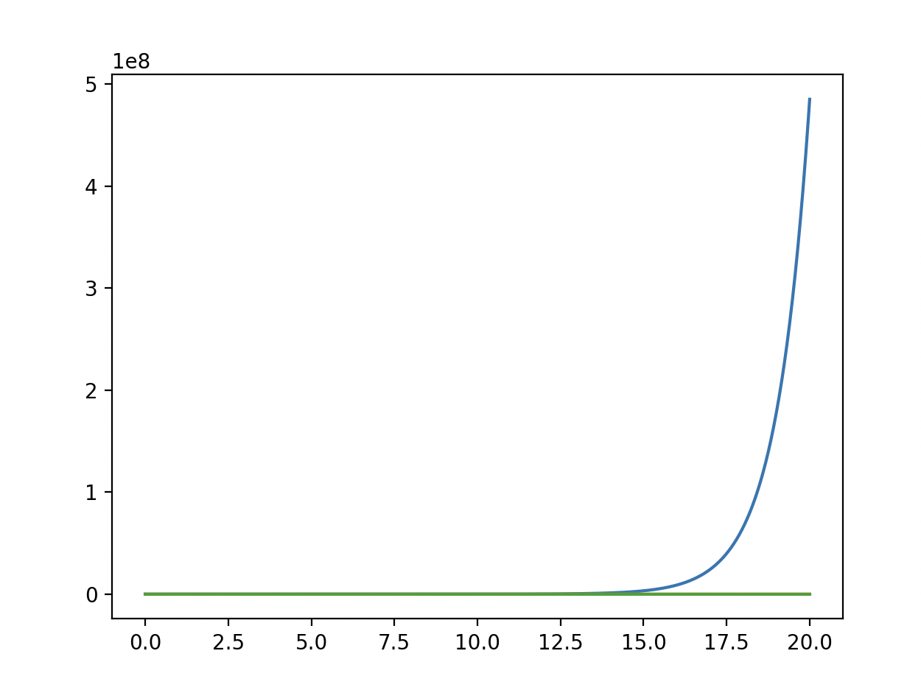
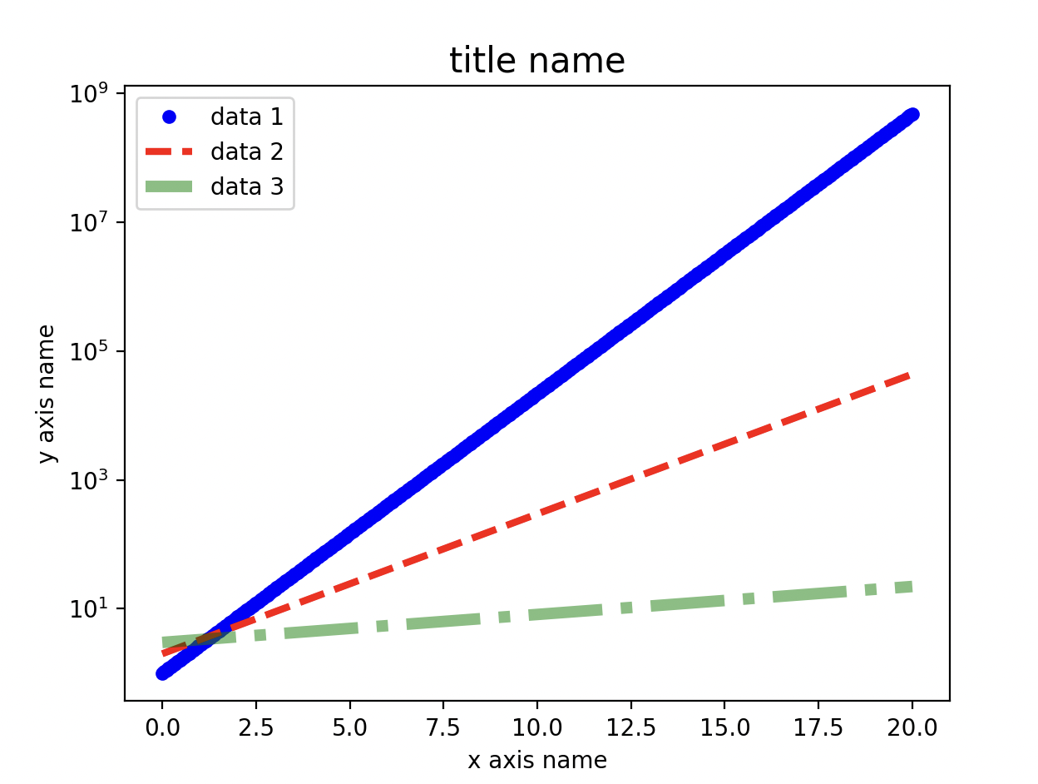
Basics (example 1)
Define axis labels and use appropriately sized font/placement
Set scale of axis appropriately: can use log scale or even user defined scales
Use legends and line styles to differentiate between different curves on the same axes.

Slide 3
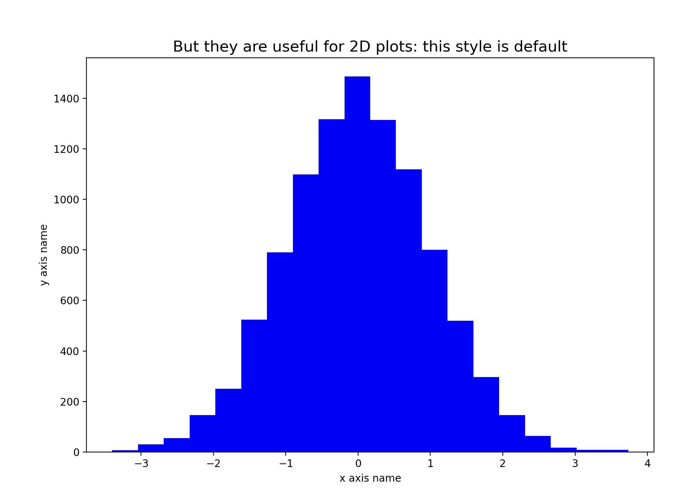
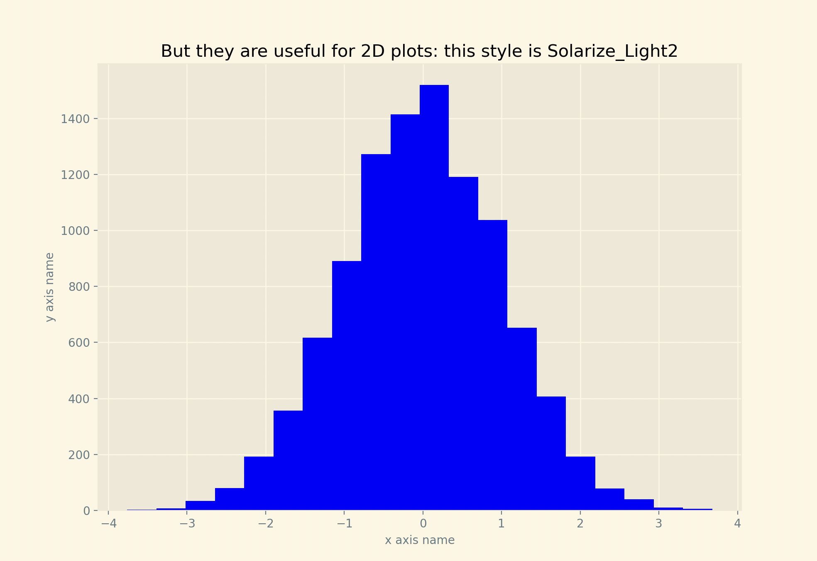
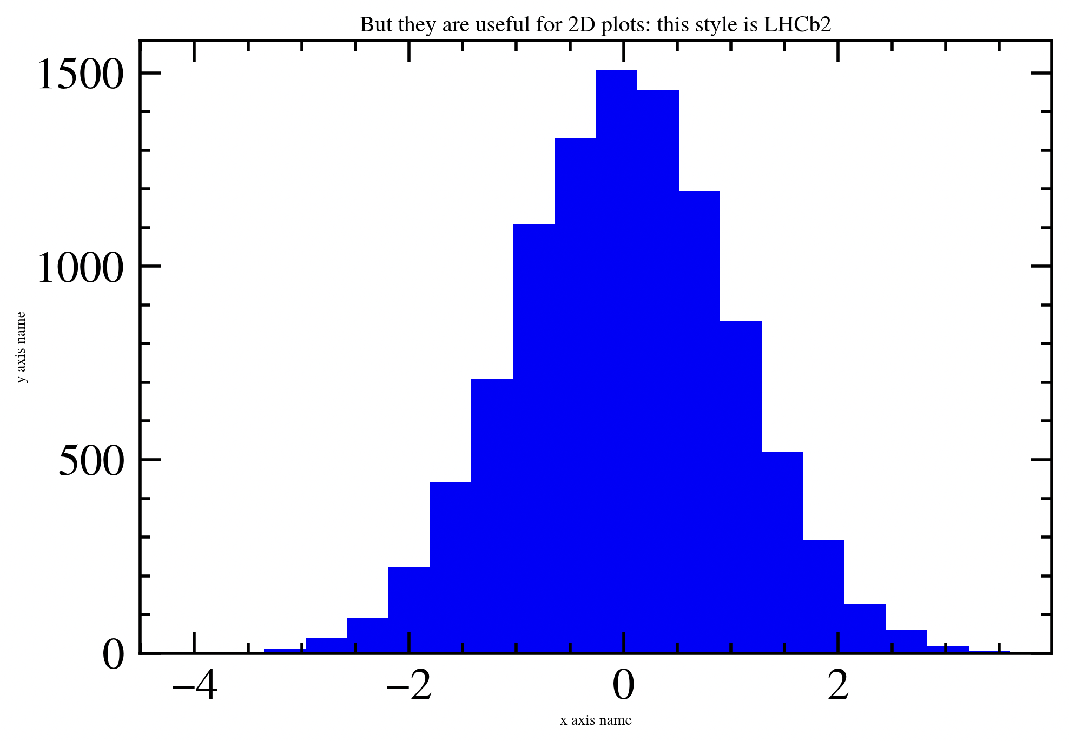
Use of Matplotlib styles (example 2)
Matplotlib has many built in styles that can easily improve the aesthetics of your plot
Some python packages add styles specific to areas of work. Ie, mplhep adds a style option to matplotlib to accommodate high energy particle physics users.
Changing styles only affects some types of plots
default
Solarize_Light2
LHCb2

Slide 4
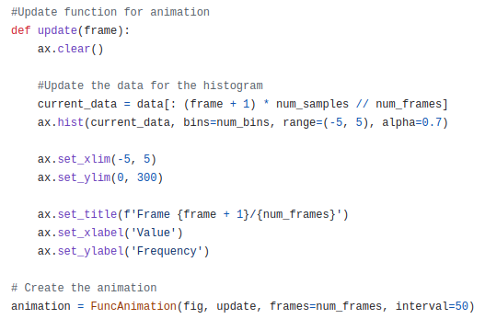
Animations (example 3)
Use the FuncAnimation function in matplotlib to display animations which aids live visualizations.
Important part is to define a function that update frames in the plot, and the function will be passed as an argument to the FuncAnimation function.
Applying this to a 1D histogram of a gaussian distribution, we can have a nice visualization.

Slide 5
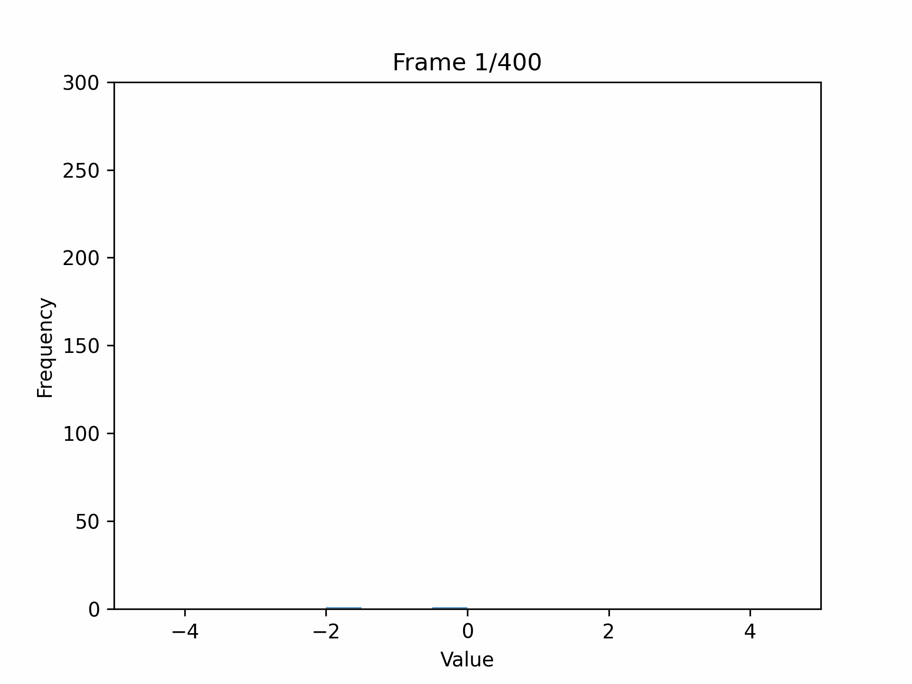

Slide 6
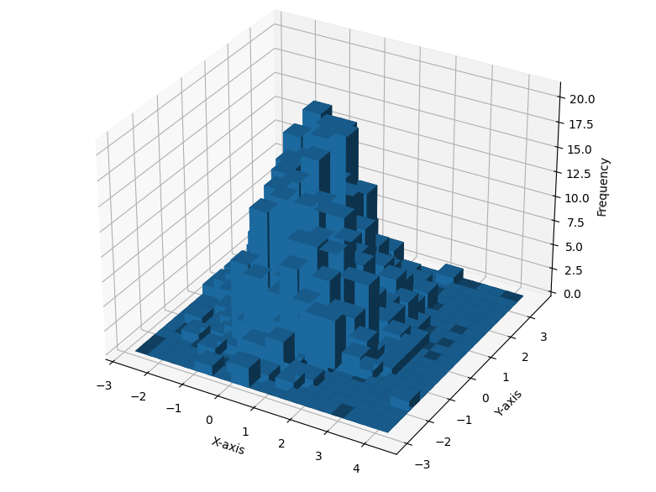
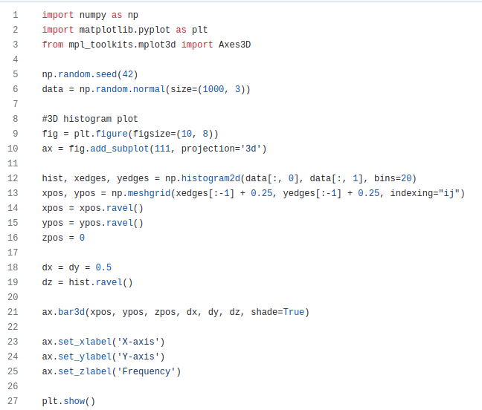
3D plots with matplotlib (example 4)
By importing the necessary libraries for 3d plot (e.g. Axes3D), we can make a nice 3D histogram.

Slide 7
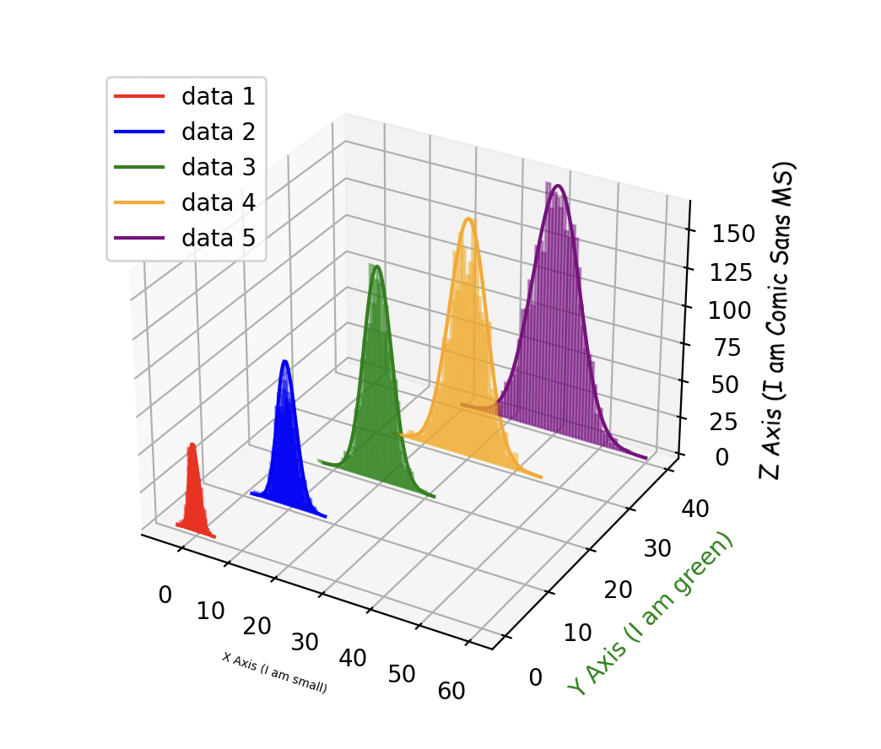
Activity: Recreate this plot using the Activity.py template on github

